Slide 1
Matrices
Matrices can be related to arrays in a programming language. In other Mathematic topics, it can be used in graph theory by describing adjacency, using geometric shapes, simultaneous equations can be solved by using Matrices.
As shown below, this starts by using columns, rows and surrounded by brackets. Each column and row can be extended both ways as much. Therefore, below is shown 2x3 matrix.
⎛
3
1
-7
⎞
⎜
⎟
⎜
2
11
-2
⎟
⎝
⎠

Slide 2
Addition, Subtraction and Multiplication of Matrices:
D
A
=
⎛
⎞
B
=
⎛
3
4
5
⎞
C
=
⎛
⎞
6
5
-2
5
6
5
=
⎛
3
4
⎞
⎜
⎟
⎜
⎟
⎜
⎟
⎜
⎟
⎜
⎟
⎜
2
-4
2
⎟
⎜
4
⎟
⎜
⎟
⎝
4
7
0
⎠
⎝
⎠
⎝
7
⎠
⎝
2
4
⎠
A+B =
⎛
9
9
3
⎞
A-B =
⎛
⎞
⎜
⎟
3
1
-7
⎜
⎟
⎜
6
3
2
⎟
⎜
⎟
⎝
⎠
⎝
2
11
-2
⎠
C*D =
⎛
28
44
⎞
⎜
⎟
To divide, we only invert it and multiply.
⎜
26
44
⎟
⎝
⎠

Slide 3
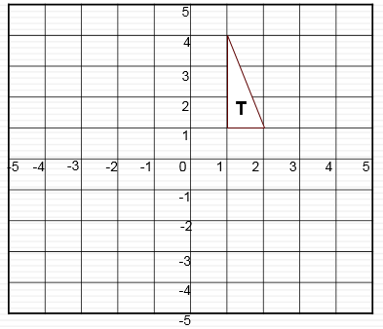
T =
⎛
1
1
2
⎞
⎜
⎟
⎜
1
4
1
⎟
⎝
⎠
You can plot Matrics on the first row as x-axis and the second row as y-axis. By plotting them, as shown above, it can come out with an shape or line. To reflect it, we use different types of matrices depending on what angle you want it reflected.

